Slide 1


Беспроводные сети нового уровня – Wi-Fi 6 и решения HPE Aruba
Алексей Цемарков
Архитектор Сетевых Решений HPE Aruba
ta@hpe.com

Slide 2

РЕШЕНИЯ, КОТОРЫЕ ПОМОГАЮТ ИНДУСТРИИ РАЗВИВАТЬСЯ
УНИКАЛЬНЫЙ КЛИЕНТСКИЙ ОПЫТ
МОСТИК МЕЖДУ
ФИЗИЧЕСКОЙ
И ЦИФРОВОЙ РЕАЛЬНОСТЬЮ
Notes:
Aruba knows that a great network is only as good as the experiences it delivers. And to deliver on experience expectations, we must bridge the physical world with the digital world in a way that helps our customer deliver on their vision and mission. Today, more than ever, industries are innovating in ways that drive amazing experiences.

Slide 3













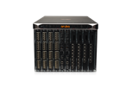
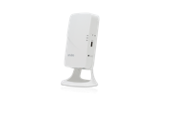



НАША
МИССИЯ
Мы развиваем платформу, которая является фундаментом для Ваших инноваций в эру мобильности, IoT и облачных технологий
Технологические
Партнеры
Бизнес
Партнеры
Альянсы
Airheads и
Разработчики
BEST-IN-CLASS
ECOSYSTEM
Эксплуатация
Безопасность
Геолокация
SD-WAN
SOFTWARE
PLATFORM
Aruba OS
AirWave / Central
ClearPass
IntroSpect
Meridian
SECURE
INFRASTRUCTURE
VIA CLIENT
WIRED CORE/AGG
WI-FI | BLE | TAGS
REMOTE ACCESS
WIRED ACCESS
WAN
EDGE COMPUTE
Mobile First | Secure | Open | Autonomous

Slide 4
































CLOUD
MOBILE
IOT
Notes:
It started as the mobile edge, then it became the cloud-enabled edge, and now it’s becoming the IoT edge.

Slide 5
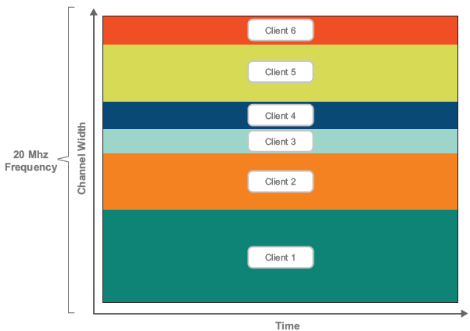
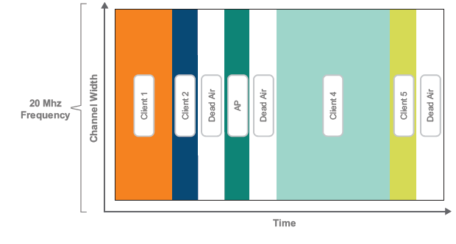
OFDM в Wi-Fi 5 против OFDMA в Wi-Fi 6
OFDM – используется сегодня в .11ас
OFDMA – появляется в .11ах

Slide 6
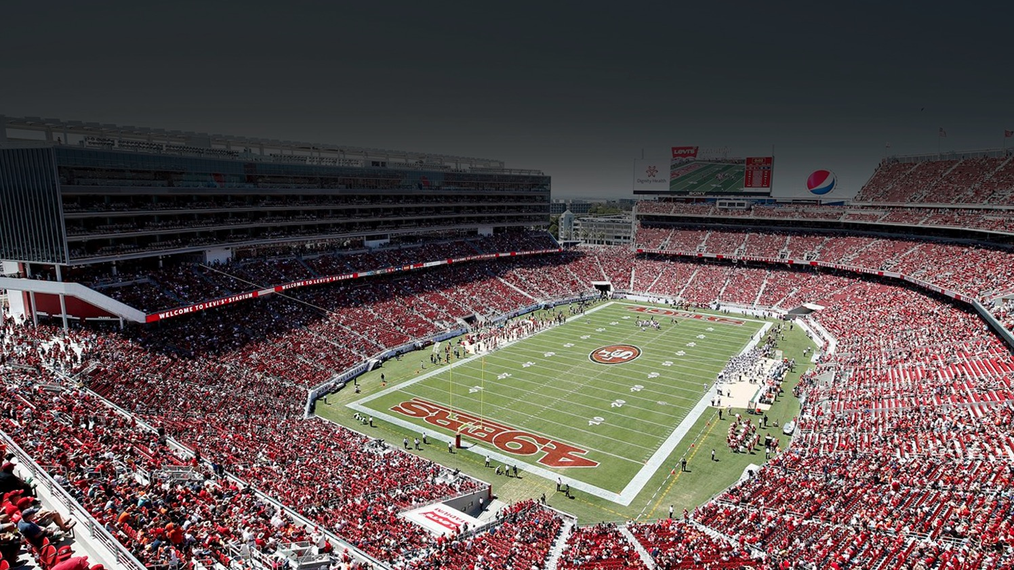
San Francisco 49ers Levi’s Stadium
Wi-Fi для книги рекордов
71,088
Уникальных пользователей
10.1 TB
трафика
Notes:
Large reference

Slide 7

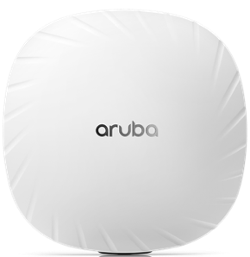
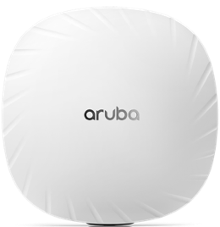
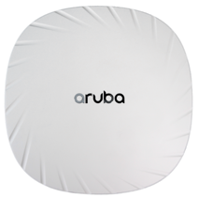
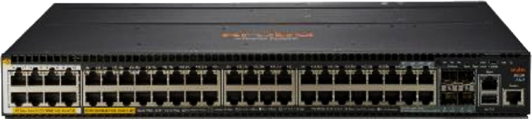
Интеграция Bluetooth 5 and Zigbee Radio
ARUBA
WI-FI 6
различные механизмы подключения
510 Series
530 Series
550 Series
Aruba 2930M
Switch 802.3bt

Slide 8







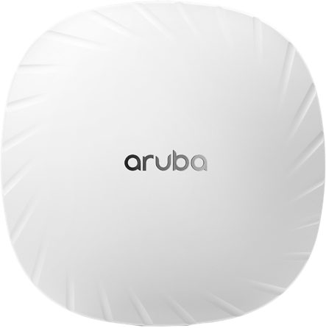


















Точки доступа ARUBA
КАК IOT ПЛАТФОРМА
Multiple radio access networks (Multi-RAN)
Wi-Fi 6 (802.11ax)
Bluetooth 5 и BLE
802.15.4 включая Zigbee
Другие протоколы
SOFTWARE
AS A SERVICE

Slide 9
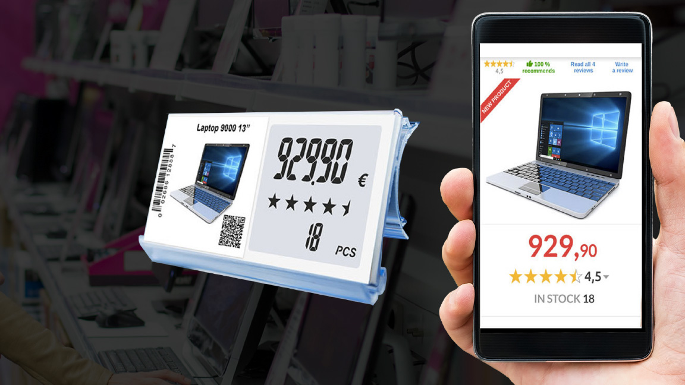
СОВЕРШЕНСТВУЕМ КЛИЕНТСКИЙ ОПЫТ
В РЕАЛЬНОМ МИРЕ
Электронные ценники
Enhanced Shopping Experience

Slide 10


СОВЕРШЕНСТВУЕМ КЛИЕНТСКИЙ ОПЫТ
В РЕАЛЬНОМ МИРЕ
Цифровые замки
Enhanced Hospitality Experience

Slide 11





AI/ML
  Автоматизация Конфигурации
Обнаружение Аномалий
Искусственный Интеллект и Машинное Обучение
AUTOMATED
NETWORK OPERATIONS
Поиск Возможности Оптимизировать
Корреляция Производительности Сети
Notes:
IT increasingly worries about simplifying the management model and moving from a manual troubleshooting, incident resolution focus to data driven insights, decisions for closed loop automation of network operations.
AI/ML plays a big role in
i. Augmenting IT by helping
ii. “Automate config changes with minimal IT oversight”
One of the primary goals of network operations is to guarantee great end user experience. Our solution innovation is focused on
i. Proactively tracking end user experience
ii. Identify anomalies
iii. Correlate with network performance
iv. Make prescriptive recommendations that can be automated or implemented manually based on the use case and issue to improve end user experience.
This is how AI/ML innovation is “becoming Central” to our Aruba Central cloud solution.

Slide 12

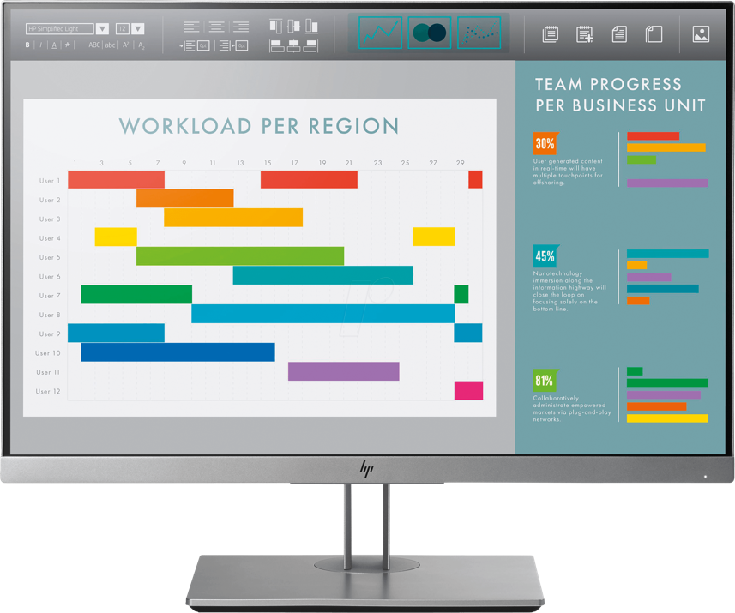
ВЗГЛЯД
СО СТОРОНЫ СЕТИ
NETINSIGHT
Proactive | Insights | Autonomous

Slide 13




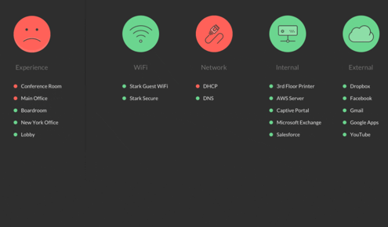
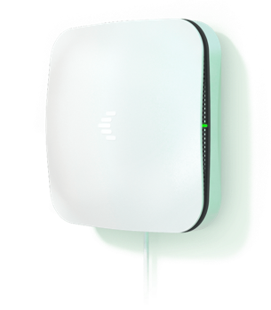

ВЗГЛЯД
СО СТОРОНЫ ПОЛЬЗОВАТЕЛЯ
ТЕСТ WI-FI И ПРИЛОЖЕНИЙ. НАЙТИ ПРОБЛЕМУ РАНЬШЕ ПОЛЬЗОАВТЕЛЕЙ.
SOFTWARE
AS A SERVICE
SENSOR
“UXI has saved me money, made me money, and made me look great all at the same time.“

Slide 14






VISIBILITY
Device Discovery and Profiling
Custom Fingerprinting
ARUBA
модель защиты
«нулевое
доверие»
DETECTION AND
RESPONSE
Attack Response
Event-triggered actions
SECURE AIR
WPA-3, SAE/
OWE, Suite B
AUTHENTICATION
One Role, One Network
AAA and Non-
AAA Options
ROLE-BASED
ACCESS CONTROL
Precision Access Privileges
Identity and context-based rules

Slide 15
Так о чем это все?
ARUBA EDGE является платформой для Next-gen сетей
Надежность
Минимум простоя и тех окон
Клиент не видит никаких проблем даже с голосом и видео даже во время аварии
Самый умный Wi-Fi и LAN
Технологии AI, ClientMatch, AppRF, AirMatch, Clustering создающие сеть которая просто РАБОТАЕТ
Высокая масштабируемость
Zero Touch provisioning
Hierarchical Config
Виртуализация
Постоянная балансировка
Безопасность
Унифицированный проводной и беспроводной доступ
Динамическая сегментация
Новейшие стандарты защиты

Slide 16

Analyst Validation Supports Aruba’s Position as a Market Leader
Magic Quadrant
Critical Capabilities
New Wave
MarketScape
1 of only 2 Leaders
14th consecutive year as a Leader
Consecutive year leading 5 of 6 Use Cases
The only vendor placed in the Leaders Quadrant
Gartner, Critical Capabilities for Wired and Wireless LAN Access Infrastructure , Christian Canales, Tim Zimmerman, Bill Menezes, Mike Toussaint – 26 September 2019
Gartner Magic Quadrant for the Wired and Wireless LAN Access Infrastructure - September 2019 Bill Menezes, Christian Canales, Tim Zimmerman, Mike Toussaint - ID Number: G00368944
Aruba’s 14 years of placement includes HPE (Aruba) in the Magic Quadrant for the Wired & Wireless LAN Access Infrastructure from 2015-2019 (5 years), Aruba Networks in the same Magic Quadrant from 2012-2014 (3 years) and in the Magic Quadrant for Wireless LAN Access Infrastructure from 2006-2011 (6 years).
These graphics were published by Gartner, Inc. as part of a larger research document and should be evaluated in the context of the entire document. The Gartner document is available upon request from Aruba Networks
Gartner does not endorse any vendor, product or service depicted in its research publications, and does not advise technology users to select only those vendors with the highest ratings or other designation. Gartner research publications consist of the opinions of Gartner’s research organization and should not be construed as statements of fact. Gartner disclaims all warranties, expressed or implied, with this research, including any warranties of merchantability or fitness for a particular purpose.
The Forrester New Wave™ is copyrighted by Forrester Research, Inc. Forrester and Forrester Wave™ are trademarks of Forrester Research, Inc. The Forrester New Wave™ is a graphical representation of Forrester's callon a market. Forrester does not endorse any vendor, product, or service depicted in the Forrester New Wave™. Information is based on best available resources. Opinions reflect judgment at the time and are subject to change.

Slide 17
A Market Leader 14 Years Running¹
¹ Aruba’s 14 years of placement includes HPE (Aruba) in the Magic Quadrant for the Wired & Wireless LAN Access Infrastructure from 2015-2019 (5 years), Aruba Networks in the same Magic Quadrant from 2012-2014 (3 years) and in the Magic Quadrant for Wireless LAN Access Infrastructure from 2006-2011 (6 years).
Source: Gartner Magic Quadrant for the Wired and Wireless LAN Access Infrastructure
September 2019 Bill Menezes, Christian Canales, Tim Zimmerman, Mike Toussaint
ID Number: G00368944
This graphic was published by Gartner, Inc. as part of a larger research document and should be evaluated in the context of the entire document. The Gartner document is available upon request from Aruba, a Hewlett Packard Enterprise company. Gartner does not endorse any vendor, product or service depicted in its research publications, and does not advise technology users to select only those vendors with the highest ratings or other designation. Gartner research publications consist of the opinions of Gartner’s research organization and should not be construed as statements of fact. Gartner disclaims all warranties, expressed or implied, with respect to this research, including any warranties or merchantability or fitness for a particular purpose.

Slide 18
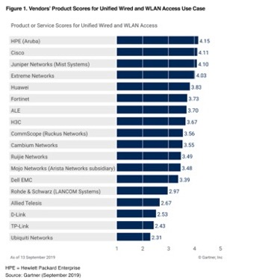
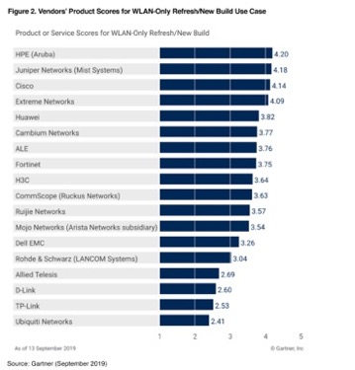
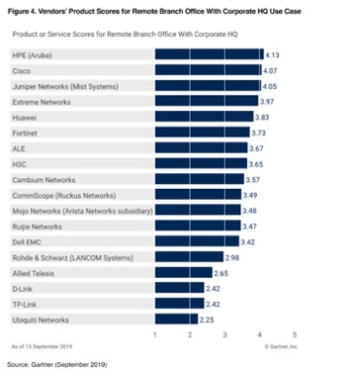
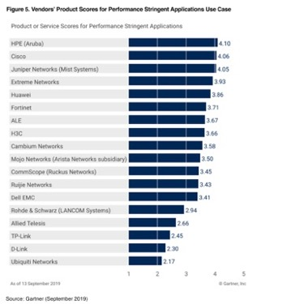
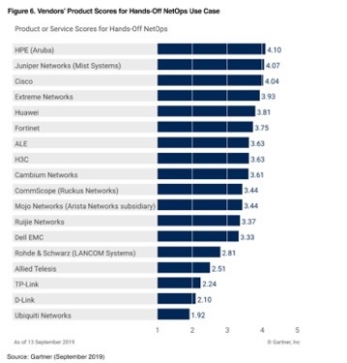
Aruba receives highest product scores in 5 out of 6 uses cases in Gartner’s Critical Capabilities Report¹
Unified Wired & WLAN Access
WLAN-Only
Refresh/New Build
Remote Branch Office
with Corp HQ
Performance Stringent
Applications
Hands-Off NetOps
1 – Gartner, Critical Capabilities for Wired and Wireless LAN Access Infrastructure , Christian Canales, Tim Zimmerman, Bill Menezes, Mike Toussaint – 26 September 2019
These graphics were published by Gartner, Inc. as part of a larger research document and should be evaluated in the context of the entire document. The Gartner document is available upon request from Aruba Networks
Gartner does not endorse any vendor, product or service depicted in its research publications, and does not advise technology users to select only those vendors with the highest ratings or other designation. Gartner research publications consist of the opinions of Gartner’s research organization and should not be construed as statements of fact. Gartner disclaims all warranties, expressed or implied, with this research, including any warranties of merchantability or fitness for a particular purpose.

Slide 19
IDC MarketScape: WW Enterprise WLAN Vendor Assessment 2019​
Aruba is one only two companies positioned as a Leader
“The flexibility of the company's WLAN portfolio to span both on-premises and cloud-based management, along with a tightly-integrated switching platform, and robust management, security and analytics software tools combine to appeal to a broad spectrum of the market, from large enterprises to mid-size businesses.” – IDC MarketScape: Worldwide Enterprise WLAN 2019 Vendor Assessment
Source: IDC MarketScape: Worldwide Enterprise WLAN 2019 Vendor Assessment, doc #US45066719, October 2019
IDC MarketScape vendor analysis model is designed to provide an overview of the competitive fitness of ICT suppliers in a given market. The research methodology utilizes a rigorous scoring methodology based on both qualitative and quantitative criteria that results in a single graphical illustration of each vendor’s position within a given market. The Capabilities score measures vendor product, go-to-market and business execution in the short-term. The Strategy score measures the alignment of vendor strategies with customer requirements in a 3-5-year timeframe. Vendor market share is represented by the size of the icons.

Slide 20
The Forrester New Wave™: Wireless Solutions, Q3 2019
“Aruba Leads the Pack”
Forrester notes Aruba “Is the best fit for companies needing advanced wireless services.”
“Customers praised Aruba Networks’ rich management interfaces, monitoring tools, and location services, especially the ability to connect IoT devices using wireless options outside of just using Wi-Fi with Aruba’s access points (APs)."
The Forrester New Wave™ is copyrighted by Forrester Research, Inc. Forrester and Forrester Wave™ are trademarks of Forrester Research, Inc. The Forrester New Wave™ is a graphical representation of Forrester's callon a market. Forrester does not endorse any vendor, product, or service depicted in the Forrester New Wave™. Information is based on best available resources. Opinions reflect judgment at the time and are subject to change.

Slide 21

Спасибо!
ta@hpe.com

