Slide 1



Организация больших массивов данных
Максим Зубарев
Директор Департамента корпоративных продаж
EMC Россия

Slide 2
Цифровая информация
Рост в геометрической прогрессии
4
2,502
Экзабайт
2,500
года
за
5
Exabytes
DVD
RFID
Digital TV
MP3 players
Digital cameras
Camera phones, VoIP
Medical imaging, Laptops,
Data center applications, Games
Satellite images, GPS, ATMs, Scanners
Sensors, Digital radio, DLP theaters, Telematics
Peer-to-peer, Email, Instant messaging, Videoconferencing,
CAD/CAM, Toys, Industrial machines, Security systems, Appliances
2,000
кратный рост
1,500
1,000
486
Экзабайт
500
0
2008
2009
2010
2011
2012
Источник: IDC Digital Universe White Paper, Sponsored by EMC, May 2009
Notes:
The Digital Universe will grow from 487 Exabytes (487 billion gigabytes) in 2008 to 2,502 Exabytes (or 2.5 Zattabytes) in 2012. that’s a 5-fold growth in only four years. The implications are huge: Organizations that understand how fast the digital universe is expanding and manage their businesses accordingly will be the ones that can compete cost-effectively and win in the coming years.
Note:
Calculated at 487 billion gigabytes in size, the amount of information created in 2008 is the equivalent of more than:
237 billion fully-loaded Amazon Kindle wireless reading devices
4.8 quadrillion online bank transactions
3 quadrillion Twitter feeds
162 trillion digital photos
30 billion fully-loaded Apple iPod Touches
19 billion fully-loaded Blu-ray DVDs

Slide 3
Рост цифровой информации в разы опережает рост ИТ ресурсов на ее управление
Среднегодовой рост за 5 лет (2008 - 2012)
51%
2%
1%
Цифровая
Вселенная
ИТ расходы
в мире
ИТ персонал
в мире
Источник: IDC Digital Universe White Paper, Sponsored by EMC, May 2009
Notes:
But over the same time period, the next four years, while the digital universe grows by a factor of five, total IT spending worldwide will only grow by a factor of 1.2, and IT staffing by a factor of 1.1.

Slide 4
ИТ-инфраструктура пора менять
Слишком сложная и неуправляемая!
ИТ-бюджет 1995
ИТ-бюджет 2010
Операци-онные расходы
Капитальные затраты
Капитальные
затраты
Операционные
расходы
Notes:
4
I think a strong case can be made that most aspects of business IT are poised for a similar change.
The problem is the state of IT itself. It doesn't matter what survey or numbers you look at; it's only a small portion of each dollar spent on IT that creates direct business benefit. Customers are spending approximately 70% of budget just keeping the lights on, and only 30% goes to things that truly differentiates the company. The vast majority of IT investment is spent on keeping the lights on, upgrading various pieces of infrastructure, providing redundancy and recoverability -- all the non-value-producing aspects that seem to consume 60-80% of IT expenditures.
Second, people are frustrated. Most business leaders seem frustrated with the current state of affairs regarding IT investment, and certainly many of the people I meet in IT organizations are frustrated as well. The Board of Directors of companies is starting to figure this out, and asking: “I hear about these clouds like Google or Amazon. Why can’t we do that – operate our IT with the same degree of efficiency. Or if we can’t get it done internally, shouldn’t we outsource to the clouds? May be we should get rid of you IT guys, and we should start spending our money with Google or Amazon.” This may sound simplistic but it is indicative of the frustration that is building up.
Finally, there's a lot of new thinking emerging on how IT gets done. We've got all sorts of relatively fresh concepts to work with: virtualization, cloud, SOA, SaaS and much more. Certainly, if you believe that IT is capable of structural change, certainly the conditions are favorable in many regards.
Additional notes:
-data center growing at unsustainable rates in terms of capex/opex, power, downtime and utilization
-cost without benefit seen poorly; IT needs to be efficient and leverage scale
-new technologies available (virtualization, cloud, SOA, SaaS): how does one make use of them

Slide 5
«Точка перегиба»
Новая модель:
Эффективность,
Выбор,
Контроль
ИТ сегодня
Существующая модель:
Высокие завтраты,
сложность, и неповоротливость
Notes:
Information technology continues to be the catalyst for new business models and improving services to consumers everywhere. Technology has gone through dramatic shifts over the past 40 years and we believe that another significant shift is upon us.
With information growing faster than ever, and everyone is keeping it for longer and longer periods of time – sometimes the information is repurposed to drive new revenue streams, or it is archived to comply with regulation – whatever drives the requirement, we need more than faster technology to deal with managing it all.
We believe that it will take new ways to build, operate and consume IT.
So as we continue to improve technology and make it faster, denser and more energy efficient, we will also help introduce new IT models that keep up with information growth and avoid the potential cycle of diminishing returns from IT investment.
Точка перегиба плоской кривой — это точка кривой, в которой ее кривизна меняет знак. Для графика функции, это эквивалентно тому, что знак меняет вторая производная функции.

Slide 6
Технологии «облачных вычислений»
FAST

Slide 7
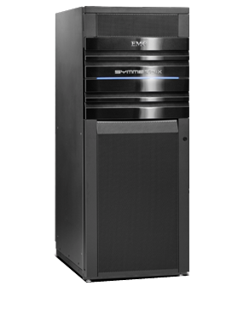

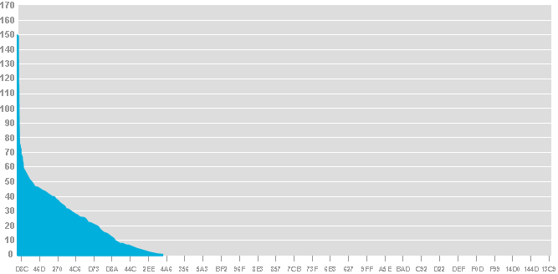


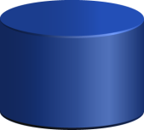

Организация уровней хранения сегодня
Перемещение
нужных данных
в нужное место
Повышение
производительности приложений
Отчет об активности дисков
Flash
V-LUN
Целевые данные
для флэш диков?
Fibre Channel
V-LUN
Целевые данные
для SATA?
Сокращение
затрат на хранение
и снижение энергопотребления
SATA
Notes:
FAST-новая технология, которая появилась в Enginuity 5874 Q4. FAST разработан для автоматического перемещения данных между различными уровнями хранения на основе анализа текущей загрузки массива. Технология позволяет оптимально использовать существующие уровни хранения и предоставлять требуемые ресурсы приложениям в нужное время

Slide 8
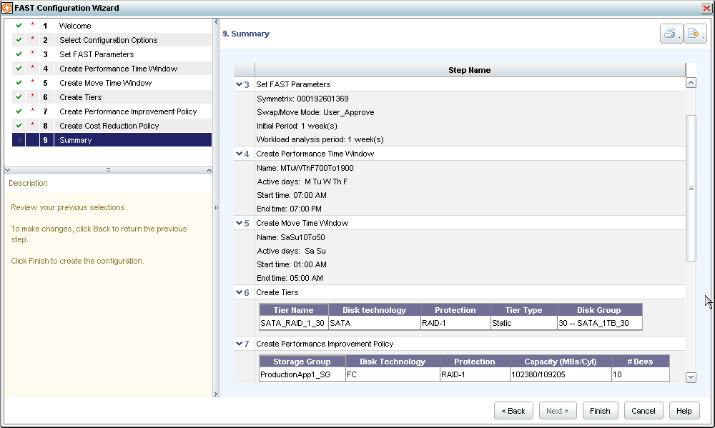
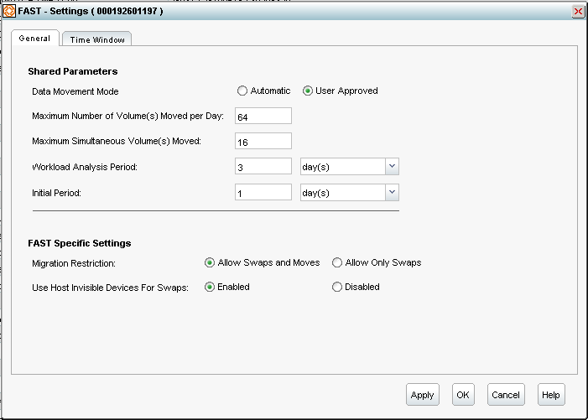
Организация уровней хранения с EMC FAST проще и полностью автоматизирована
Перемещение
нужных данных
в нужное место
…в нужное время
Flash
FAST Визард позволяет перемещать данные между уровнями хранения за минуты
Fibre Channel
SATA
Notes:
Now with FAST, this becomes easy so your customers can get the right data to the right place…at the right time.
<click>
By simply pooling storage resources, defining the policy, and applying it to an application – FAST automatically and dynamically moves data across storage tiers so that its in the right place at the right time.

Slide 9

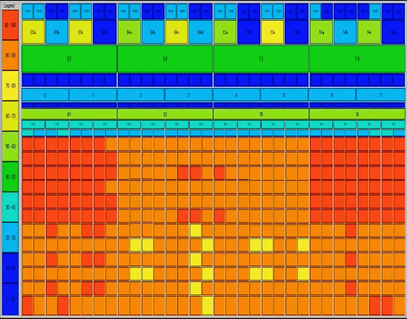


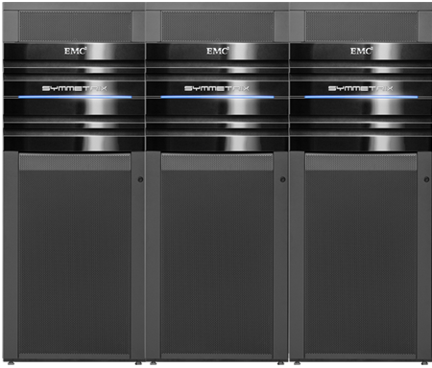
FAST в действии
Symmetrix V-Max в условиях виртуальной среды
VMware
VMware
VMware
VMware
Все диски
Fibre Channel

Slide 10
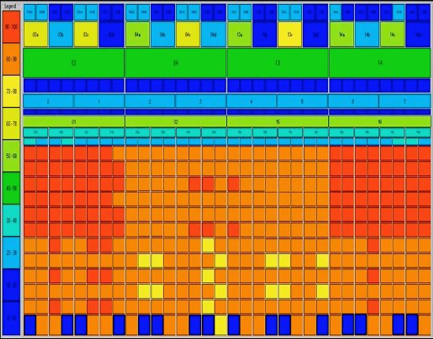
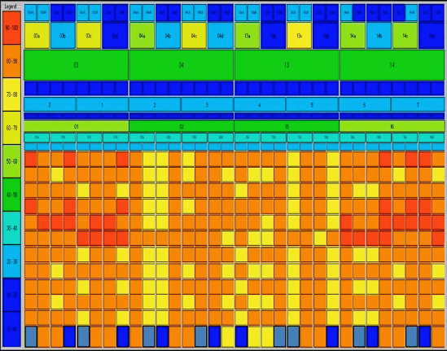
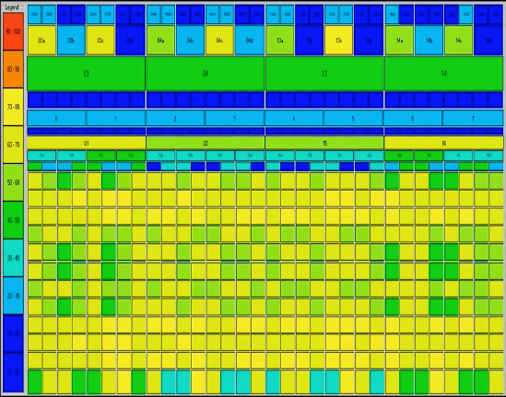
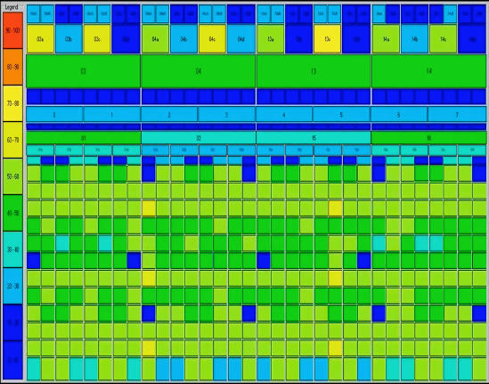
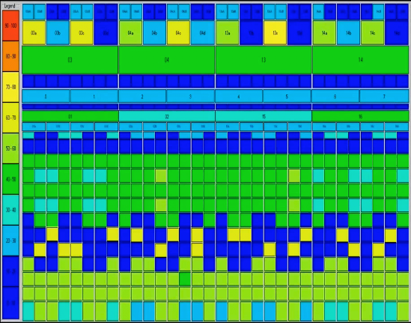
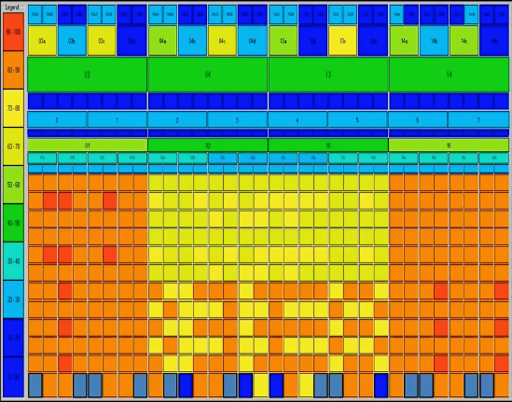
FAST в действии
Добавили Флэш-диски и применили FAST
VMware
VMware
VMware
VMware
Многоур.хран-е
4% Флэш-дисков
96% FC дисков
на 68% меньше конфликтов за диски
в 2.5X быстрее время отклика

Slide 11
Symmetrix V-Max снижает затраты с помощью многоуровневого хранения и FAST
Снижение совокупной стоимости владения за 3 года на 27%
Сокращение затрат на приобретение системы на 20%
Операционная среда Enginuity
Сокращение эксплуатационных
расходов на 43%
Пакет FAST
Операционная среда Enginuity
V-Max с двумя узлами
сырая емкость 100 Тбайт
Все интерфейсы
Fibre Channel
702 x 146 Гбайт
15 000 об/мин
(включая диски замены)
V-Max с двумя узлами
сырая емкость 100 Тбайт
Многоуровневое хранение
17 флэш-дисков по
200 Гбайт
149 x 146 Гбайт
15 000 об/мин
82 диска SATA емкостью
1 Тбайт
(включая диски замены)
Питание и охлаждение
Управление
Питание и охлаждение
Управление
Техническое обслуживание
Техническое обслуживание
Стоимость системы
хранения
FAST отсутствует
Без многоуровневого хранения
Стоимость системы
хранения
FAST с флэш-дисками,
Fibre Channel и SATA
Эксплуатационные
расходы за три года
Без FAST
Без многоуровневого хранения
Эксплуатационные
расходы за три года
FAST с флэш-дисками,
Fibre Channel и SATA
Notes:
Note to Presenter: View in Slide Show mode for animation.
Here’s an example of cost savings and cost avoidance possible with tiering and FAST.
This 100 TB Symmetrix V-Max example compares an all-Fibre Channel system without FAST to a FAST-based system configured with Flash, Fibre Channel, and SATA drives. The graphic illustrates a system acquisition cost savings of 20 percent.
Note to Presenter: Click now in Slide Show mode for animation.
On the right side, the impact to operating expenditures (OpEx) is depicted, showing a cost avoidance of 43 percent. This avoidance is made possible by fewer power and cooling requirements as well as lower management costs—specifically people resources and time—that would be required to realize the full benefits of automated tiering.
Overall, this example results in a 27 percent lower three-year total cost of ownership.

Slide 12
Технологии «облачных вычислений»
vPlex

Slide 13

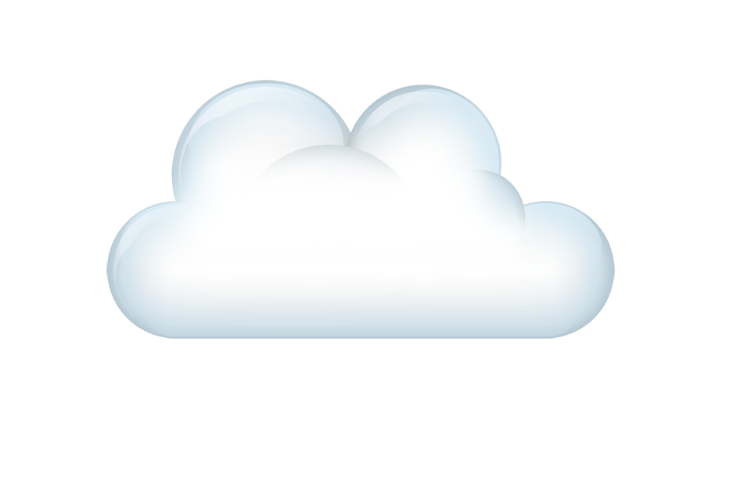
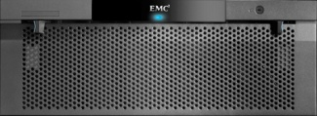
vPlex - новое слово в мобильности данных. Виртуализация систем хранения данных на расстоянии
Распределенная
когерентная кэш память
Мобильность данных и доступ с двух площадок
Совместное использование удаленной емкости
Удаленный доступ ко второй площадке
Notes:
Next use case - VPLEX METRO – DCs sync dist to 100 Kilometers
Real innovation of VPLEX - DCC over distance.
Members in group -> latest copy of data and where to get it.
Updates all members are notified of the changes.
The distributed caching protocol minimizes BW and latency
Why this is relevant?
Fundamentally change DC by creating AA data over distance.
No other technology can do this so it is a true game changer.
Not only can you move and access data…..
You can provision and share capacity at a distance
Enables RA across sites whether
For example.
13

Slide 14


vPlex - новое слово в мобильности данных.
Миграция данных на 2ю площадку за минуты, а не часы
Перемещение виртуальных машин, приложений, информации без прерывания работы
Notes:
Really cool VPLEX Metro + vMotion.
Non disruptively move and relocate ….
So now you can easily balance your applications and workloads across Data Centers.
This capability gives you new options for how you think about and plan your Data Centers.
14

Slide 15
Технологии «облачных вычислений»
vBlock
Notes:
Enterprise IT solutions over the past 30 years have become more costly to analyze and design, procure, customize, integrate, interoperate, scale, service, and maintain.
The Back Story: Customers are virtualizing their environments like crazy. They're doing it for a simple reason: to deliver a better/faster/cheaper IT service back to the business.
However, many customers are starting to realize that they're doing it piecemeal: a few servers, a few applications, a management tool here—one small step at a time.
Typically, this is how IT is done: incrementalism. But it’s not getting the job done—especially at scale.
One problem this creates is speed—the business wants the benefits of a private cloud, but traditional approaches aren't getting there fast enough.
Another serious problem is end-state—there's no clear picture of what it all looks like when they're done, and how they would build it if they knew what it looked like.
Perhaps the best analogy might be buying a new house vs. incrementally renovating an old house by adding rooms over a period of several years. If all you want to do is live in a better house, you’d be interested in buying new vs. spending many years with renovations—and still not being happy with the results!
ЦОД – состоит из множества элемента, а что если взять моноблок? Как в случае с персональными компьютерами? Моноблок, который составлен из лучшех компонентов? Каждый в своей области?
It's very dynamic. It's very efficient, it's on demand, and it's flexible. For instance, let's use the word dynamic. What happens in a data center of today is they are basically static. The application pretty much owns the infrastructure.
Say you have Microsoft Exchange. What you have to do now is build that out for the peaks. Say my peak load is before Christmas and it's in two o'clock in the afternoon. You have to buy for that peak, and that application owns those physical devices all the time.
In a cloud environment, you never own anything. You provision a workload as that workload needs resources. When it needs lots of resources, you throw more servers at it. You throw more horsepower at it. It spins down at 2 o'clock in the morning because most exchange environments are pretty lightly used then. At two o'clock in the afternoon, they're humming away.
Run any application and OS on any hardware.
Free-up fixed/locked-up capacity to create a common pool of flexible/variable capacity.
Achieve a high degree of workload/resource mobility.

Slide 16
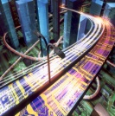


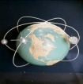
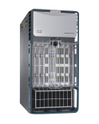
Инфраструктурные пакеты vBlock - новый подход к ИТ сервисам
Virtual Computing Environment (VCE)
Интегрированное решение
  Network (Cisco)
  Compute (Cisco UCS)
  Virtualization (VMware)
  Storage (EMC)
Единая поддержка
  vceCoalition.com
Три модели
  Vblock 0, 1, 2
Информация
Приложения
Опреацион.сис-мы
Виртуализация
Вычисления
Сеть
СХД
Инфрастурктурный пакет vBlock
Notes:
So What is the first completely integrated IT offering that combines best-of-breed networking, compute, storage, security, and management?
This integrated system that services business applications is purchased as a Vblock Infrastructure Package. It provides virtual blocks of functionality that are available at the right price and the right size, secure, de-risked, and warranted.
Vblock Infrastructure Packages completely virtualize HW infrastructure (network, compute, storage, hypervisor, and management).
Customers provide the existing O/S, application, database, and data (backup and restore) for existing or new implementations.
They deliver benefits for:
A rapid deployment model for virtualized infrastructure, to realize the value of business applications and information faster and quickly standardize across your environment.
A reduction in the total cost of ownership with integrated, tested, and validated solutions with a standard infrastructure that reduces management and maintenance costs.
A service-level-driven approach in delivering computing with predictable performance and operational characteristics that aligns with how you deliver IT services and reduces risk.
They also provide unified support to streamline and accelerate problem resolution.
Rapid deployment model for virtualized infrastructure:
Realize the value of business applications and information faster
Quickly standardize across your environment
Reduced total cost of ownership
Pre-integrated, tested, and validated solution
Standard infrastructure reduces management and maintenance costs
Service-level driven
Predictable performance and operational characteristics
Aligns with how you deliver IT services
Reduced risk
Unified support simplifies and accelerates problem resolution

Slide 17
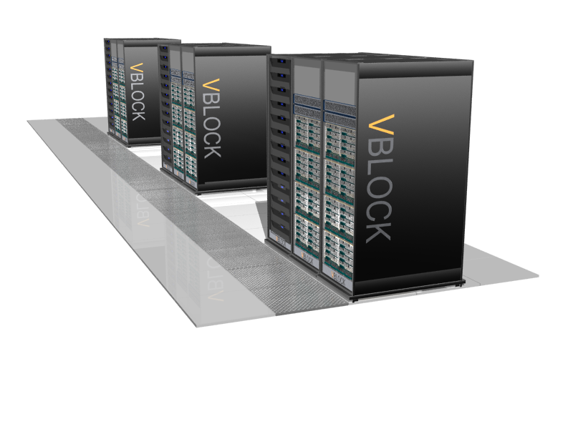
vBlock – «по дороге с облаками»
Минимальное время для развертывания виртуальной инфраструктуры
Интегрированые и проверенные решения сокращают совокупную стоимость владения
Высокий SLA благодаря предсказуемым характеристикам производительности
Высокий уровень безопасности, минимизация операционных рисков
vBlock - строительный элемент ЦОДов нового поколения
Notes:
1 Преинтегрированный (риск совместимости, оптимизированный, пример: моноблока – лучшее компоненты от лучших производителей)
2. Единая поддержка
3. Гармоничное масштабирование (масштабируемость всего ЦОДа, а не отдельного его элемента: сеть, СХД, сервера, вирт.машины, риск ошибок в сайзинге, забыли порты)
4. Сквозной SLA для бизнеса (не отдельный элементы ЦОДа, а на весь ЦОД)
5. Прозрачность по стоимости (фин.директор, выделить деньги не проблема, проблема понять, на что)
6. Быстрота развертывания
vBlock для развитых компаний. Наигрались с железом, думают о бизнесе
Опрерирование понятиями не на уровне отдельных железок, а ЦОДа в целом
Rapid deployment model
of virtualized infrastructure
Pre-integrated and validated solutions reduce total cost
of ownership
Service-level driven through predictable performance
and operational characteristics
Improved compliance/security and reduced risk

Slide 18
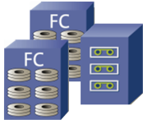
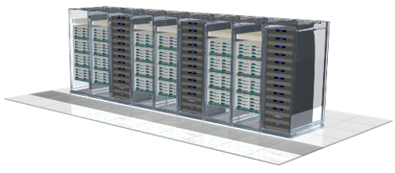
vBlock – масштабная виртуализация
Путь ИТ к стандартизации и упрощению
Управляйте сервисами, а не серверами!
V
V
V
V
V
V
V
V
V
V
V
V
V
V
V
V
Database
Virtual Desktops
Email
Custom
Web
Notes:
Vblock accelerates virtualization across a broad range of applications. By virtualizing at Scale, IT is is standardized and simplified.
Most people can appreciate the benefits of consuming infrastructure as a service: shift to a variable cost model, enjoy benefits of scale, own as much or as little infrastructure as you'd like, and so on. What's been missing is the "how", and this is where the concept of a private cloud will gain traction.
The private cloud is a new style of computing where corporate IT infrastructure is available as a ubiquitous, easily accessible, and reliable utility service conceptually similar to the telephone dial tone and electricity service. Business owners and application owners who need to roll out a new business service do not need to understand the intricacies of servers, storage and network; infrastructure is available to them as a standard service. The internal cloud brings the benefits of cloud computing under the control of corporate IT:
Easy entry and exit. Available on-demand. No need to wait for weeks or months in order to roll out a new business service. No big upfront investment to roll out a new business service. No need to buy new servers, storage and network, and configure them to work together. The service can be easily retired without paying for infrastructure depreciation for years.
Usage-based, pay-as-you-go model. CapEx becomes OpEx. Don’t build and depreciate the compute plant just pay your monthly bill.
Standardized, contractual, auditable service levels. Explicit what service you are getting.
Works with for every application. In contrast to third party proprietary cloud service providers, the internal cloud built on vSphere works for every existing and future application. no need to re-write applications
Secure / controlled. In contrast to external / third party cloud service providers, the internal cloud is 100% under the control of corporate IT.
Clearly, we're going to need a new sort of software abstraction to make all of this work. We're going to need to be able to containerize existing applications and desktops, move them and their information around at will, and provide the tools to do this reliably and securely. Paul Maritz of VMware colorfully describes this layer in a variety of ways: a virtual data center operating system, a "software mainframe" for the 21st century, or a meta-operating system that separates what applications see from the underlying resources. Anyway you describe it, this layer will have to be generally accepted as a standard, or behave in a standard manner, for this envisioned ecosystem to grow.
We believe that we can do this in evolutionary manner: we can take people from where they are today, in a series of steps to where they really want to be. In fact virtualization is the only way to get there without doing a wholesale rip and replace, and re-writing of applications (which by the way no enterprise can do). We can lay out a roadmap where every step of the way delivers value in of itself while at the same time taking companies where they need to go strategically.
Once you have started virtualizing and aggregating everything into a single pool, we will have the opportunity to show people that they can not only operate more efficiently but also operate more flexibly and more reliably. They can start using this shared infrastructure for doing test and dev, for doing better disaster recovery – two datacenters that act as failover for one another, etc. We are going to expand our value proposition from being just a CapEx value prop to being also an OpEx value prop – leading to a better IT and a better way of running applications.
As a second step we want to up-level management – get people away from managing underlying infrastructure to managing service levels based on what makes sense for their internal customers – the user of applications. For example, I want to manage factors such as how many seconds page refresh latency am I willing to tolerate, what availability do I need from this application, instead of having to reach somewhere deep down and turn a myriad of arcane knobs. We can also automate a lot of the rote management tasks, extricate IT from the business of repetitive management procedures, and at the same time enable end users to get what they need very quickly. The second step is about implementing automation for central IT and self-service for end-users.
And finally, once we have cleaned up the infrastructure, we open up the opportunity to federate with external infrastructures provided by third party providers, blending the two into a single collection of resources that you can use
We are building the Private Cloud which allows you to spend most of your time focusing on deploying applications and much less time on dealing with and managing plumbing.
Each step on the way can justify itself – that way we can tell customers: you do not need to make some big bet that may or may not pay out eventually. You can get to the future state of the Private Cloud in a series of incremental steps, and each step pays for itself.

Slide 19

Организация больших массивов данных
Максим Зубарев
Директор Департамента корпоративных продаж
EMC Россия

